Slide 1

Vocabulary for
Reading
Instruction

Slide 2
Purpose and Structure of this Resource
This resource provides information about the meanings of important terms contained in the National Literacy Learning Progressions for Reading and Viewing
It is structured to support the development of the morphological understanding of the terms for teachers and students.
WORD PARTS / MORPHEMES
phon | eme
Greek root | Suffix
meaning “sound” | meaning “unit”
The smallest unit of sound in a word
ETYMOLOGY & MEANING
AUSTRALIAN CURRICULUM DEFINITION

Slide 3
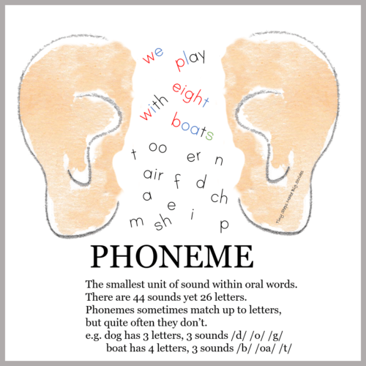
phon | eme
Greek root | Suffix
meaning “sound” | meaning “unit”
The smallest unit of sound in a word
Graphic from Tiny Steps Make Big Strides

Slide 4
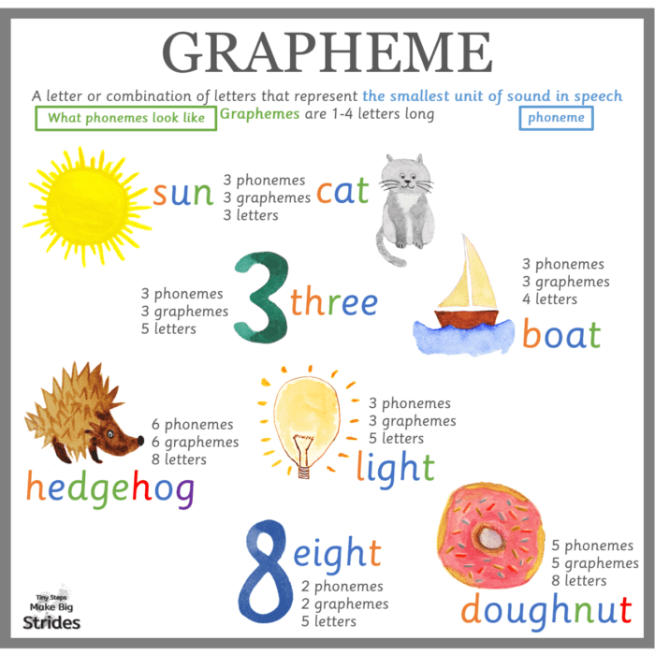
graph | eme
Greek root | Suffix
meaning “letter or symbol” | meaning “unit”
The letter or group of letters that represent the phoneme
Graphic from Tiny Steps Make Big Strides

Slide 5
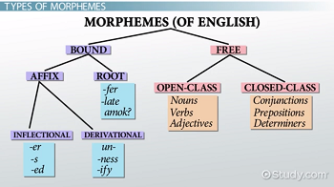
morph | eme
Greek root | Suffix
meaning “” | meaning “unit”
The smallest meaningful or grammatical unit in a language

Slide 6

phon | ics
Greek root | Suffix
meaning “sound” | meaning “pertaining to”
The ability to identify letter – sound relationships when reading or spelling

Slide 7
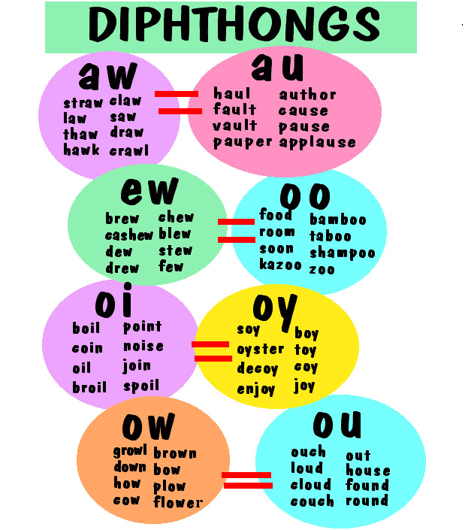
di | phthong
Prefix | Greek root (pthongos)
meaning two | meaning “sound or voice”
The combination of two adjacent vowel sounds within the same syllable

Slide 8
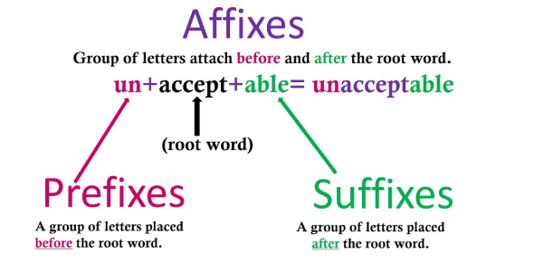
affix | prefix | suffix
Latin root (affixus) | Latin root (prae) | Latin root (suffixum)
meaning “to attach” | Meaning “before” | Meaning “to insert”
a letter or group of letters attached to the beginning or end of a word, altering the meaning

Slide 9
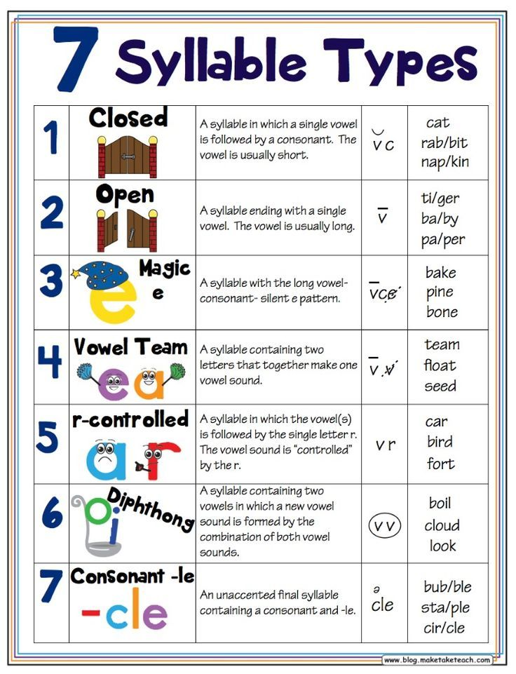
syllable
Latin root (syllaba)
meaning “to gather together”
A unit of sound within a word (for example, ‘bat’ has one syllable; ‘bat-ting has two syllables).

Slide 10
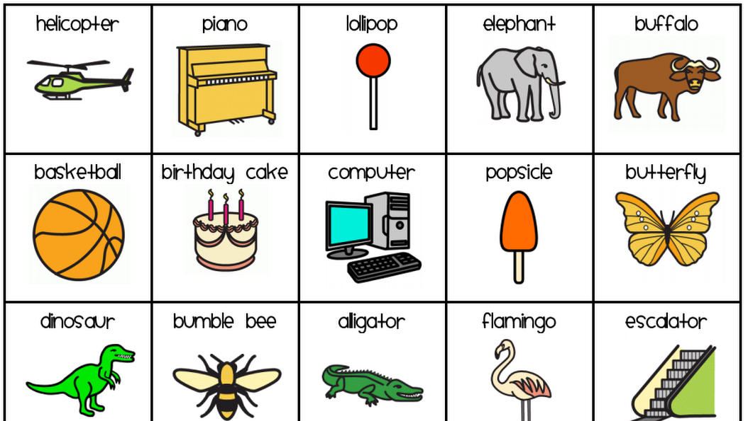
multi | syllab | ic
Latin root (multus) | Latin root (syllaba) | Latin root
Meaning “many” or “much” | meaning “to gather together” | meaning “having the properties of”
Having more than one and usually more than three syllables

Slide 11
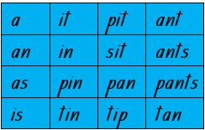
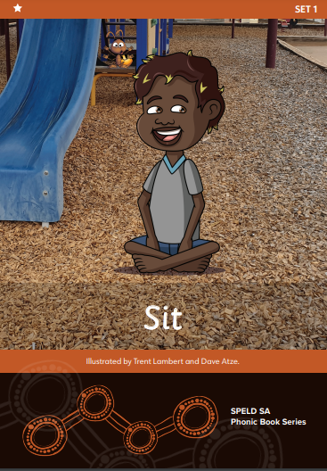
de | cod(e) | able
Prefix | Latin root (caudex) | Suffix
Meaning “to reduce or remove” | meaning “trunk of a tree used to form wooden tablets for writing” | meaning “to be able to”
Decodable means to be able to break down a word in order to be able to read it.
Simple texts | The simplest form of continuous texts and include decodable texts. Simple texts include sentences (simple and some compound) which are linked to form a cohesive text.
Decodable texts | Texts that can be read using decoding skills a student has acquired.
More information about text complexity can be found in Appendix 1 here: https://www.lpofai.edu.au/media/kw2lslug/national-literacy-learning-progression-v3-for-publication.pdf

